Slide 1
Presentation of Chapter 4, LINUX Kernel Internals
Zhihua (Scott) Jiang
Computer Science Department
University of Maryland, Baltimore County
Baltimore, MD 21250
<zhjiang@cs.umbc.edu>

Slide 2
Guideline
The Architecture-independent Memory Model in LINUX
The Virtual Address Space for a Process
Block Device Caching
Paging Under LINUX

Slide 3
The architecture-independent memory model
Pages of Memory
Virtual Address Space
Converting the Linear Address
The Page Directory
The Page Middle Directory
The Page Table

Slide 4
Pages of memory
Defined by the PAGE_SIZE macro in the asm/page.h
For X86, the size is 4k bytes
For Alpha uses 8K bytes

Slide 5
Virtual address space
Given by reference to a segment selector and the offset within the segment
C pointers hold the offsets
Defined in asm/segment.h
  KERNERL_DS (segment selector for kernel data)
  USER_DS (segment selector for user data)
By carrying out a conversion on the segment selector register, a system function can be given pointers to the kernel segment.
  Used by UMSDOS file system to simulate a Unix file system

Slide 6
Continued
MMU of an x86 processor converts the virtual address to a linear address
4 Gbytes by width of the linear address
  3 Gbytes for user segment
  1 Gbyte for kernel segment
Alpha does not support segmentation
  Offset addresses for the user segment not permitted to overlap with the offset addresses for the kernel segment

Slide 7
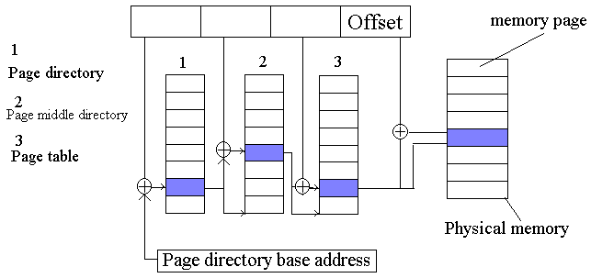
Converting the linear address
Linear address
Linear address conversion in the architecture-independent memory model

Slide 8
The virtual address space for a process
The User Segment
Virtual Memory Areas
The System Call brk
Mapping Functions
The Kernel Segment
Static Memory Allocation in the Kernel Segment
Dynamic Memory Allocation in the Kernel Segment

Slide 9
The user segment
In user mode, access only in user segment
Individual page tables for different processes
system call fork
  child and parent processes have different page directories and page tables
  however, in the kernel segment page tables are shared by all processes
system call clone
  old and new threads share the memory fully

Slide 10
Continued
Some explanation for shared libraries in the user segment
  Originally, linked into one binary, lead to efficiency
  Drawback is the growth of the length
  Stored in separate files and loaded at program start
  Linked to static addresses
  With ELF, allowed shared libraries to be loaded during program execution
  No absolute address references in the compiled code

Slide 11
Virtual memory areas
Process not use all functions at any time
Process can share codes if they are run by the same executable file
Copy-on-write strategy used for memory management

Slide 12
The system call brk
The brk field points to the end of the BSS segment for non-statically initialized data
Used for allocating or releasing dynamic memory
The system call brk can be used to find the current value of the pointer or to set it to a new one under protection check
Rejected if the mem required exceeds the estimated size
function sys_brk() calls do_map() to map a private and anonymous area between the old & new values of brk

Slide 13
Mapping functions
C library provides 3 functions in sys/mman.h
  caddr_t mmap(caddr_t addr, size_t len, int prot, int flags, int fd, off_t off);
  int munmap(caddr_t addr, size_t len);
  int mprotect(caddr_t addr, size_t len, int prot);
  int msync;

Slide 14
The kernel segment
In x86 architecture, a system call is generally initiated by the software interrupt 128 (0x80) being triggered.
Any processes in system mode will encounter the same kernel segment
Kernel segment in alpha architecture cannot start at addr 0
A PAGE_OFFSET is provided between physical & virtual addrs

Slide 15
Static memory allocation in the kernel segment
Initialization routine for character-oriented devices is called as follows
memory_start = console_init(memory_start, memory_end);
Reserves memory by returning a value higher than the parameter memory_start
The memory between the return value and memory_start can be used as desired by the initialized component

Slide 16
Dynamic memory allocation in the kernel segment
In LINUX kernel, kmalloc() and kfree() used for dynamic memory allocation
  void * kmalloc(size_t size, int priority);
  void kfree(void *obj);
To increase efficiency, the memory reserved is not initialized
In LINUX kernel 1.2, __get_free_pages() only to reserve contiguous areas of memory of 4, 8, 16, 32, 64, and 128 Kbytes in size
kmalloc() can reserve far smaller areas of memory

Slide 17
Continued
Sizes[] contains descriptors for different for different sizes of memory area
  one manages memory suitable for DMA
  the other is responsible for ordinary memory

Slide 18
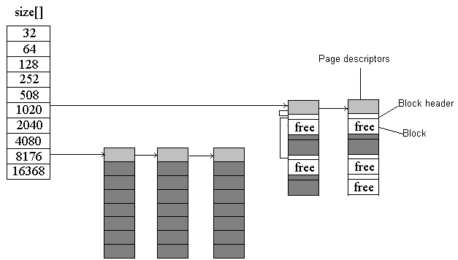
Continued
Structures for kmalloc

Slide 19
Continued
Kmalloc() and kfree() restricted to the size of one page of mem
vmalloc() and vfree() improved to multiple of the size of one page of mem
The max of value of size is limited by the amount of physical memory available
Memory reserved by vmalloc() won’t be copied to external storage

Slide 20
Continued
Comparison of vmalloc() and kmalloc()
  the size of the area of memory requested can be better adjusted to actual needs
  Limited only by the size of free physical memory and not by its segmentation (as kmalloc() is)
  Does not return any physical address
  reserved memory can be non-consecutive pages
  not suitable for reserving memory for DMA

Slide 21
Block Device Caching
Block Buffering
The update and bdflush Processes
List Structures for the Buffer Cache
Using the Buffer Cache

Slide 22
Block Buffering
Block size may be 512, 1024, 2048, or 4096 bytes
Held in memory via a buffering system
A special case applies for blocks taken from files opened with the flag 0_SYNC
  Transferred to disk every time their contents are modified
Data is organized as frequently requested data lie every close together & can be kept in the processor cache

Slide 23
The update and bdflush Processes
At periodic intervals, update process calls the system call bdflush with an parameter
All modified buffer blocks are written back to disk with all superblock and inode information
bdflush, writes back the number of blocks buffers marked “dirty” given in the bdflush parameter
Always activated when a block is released by means of brelse()
Also activated when new block buffers are requested or the size of the buffer cache needs to be reduced

Slide 24
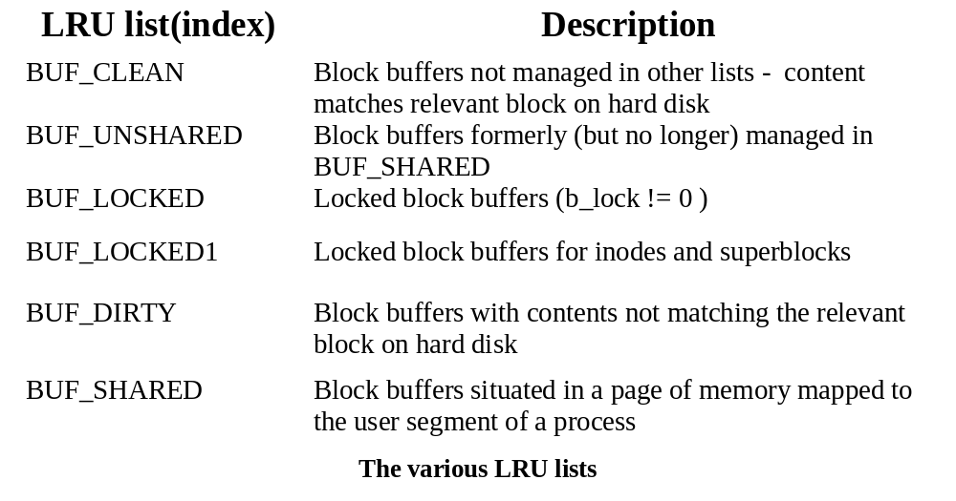
List structure for the buffer cache
LINUX manages its block buffers via a number of different doubly linked lists
Block buffers in use are managed in a set of special LRU lists

Slide 25
Using the buffer cache
Function bread() is called for block read
Variance of bread(), breada(), reads not the block requested into the buffer cache but a number of following blocks

Slide 26
Paging under LINUX
Page Cache and Management
Finding a Free Page
Page Errors and Reloading a Page

Slide 27
Page Cache and Management
LINUX can save pages to extenral media in 2 ways
  a complete block device as the external medium, typically a partition on a hard disk
  fixed-length files on a file system for its external storage
Data that belong together are stored in a cache line (16 bytes)

Slide 28
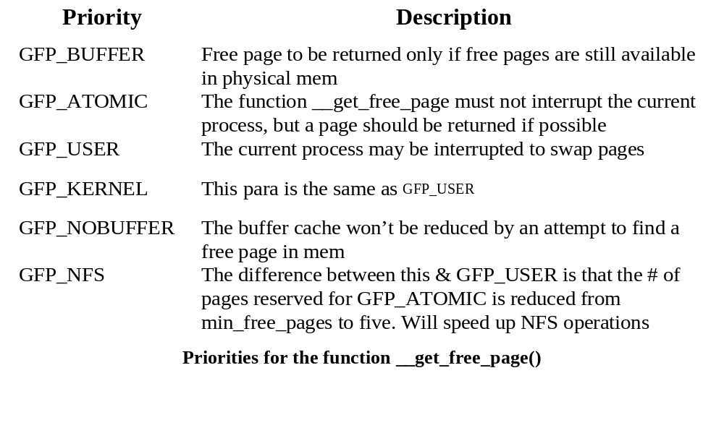
Finding a free page
__get_free_pages() is called after physical pages of mem reserved
  unsigned long __get_free_pages(int priority, unsigned long order, int dma) ;

Slide 29
Page errors and reloading a page
do_page_fault() is called when there generates a page fault interrupt
  void do_page_fault(struct pt_regs *regs, unsigned long error_code);
do_no_page() or do_wp_page() is called when the address is in a virtual memory area, the legality of the read or write operation is checked by reference to the flags for the virtual mem

